Slide 1
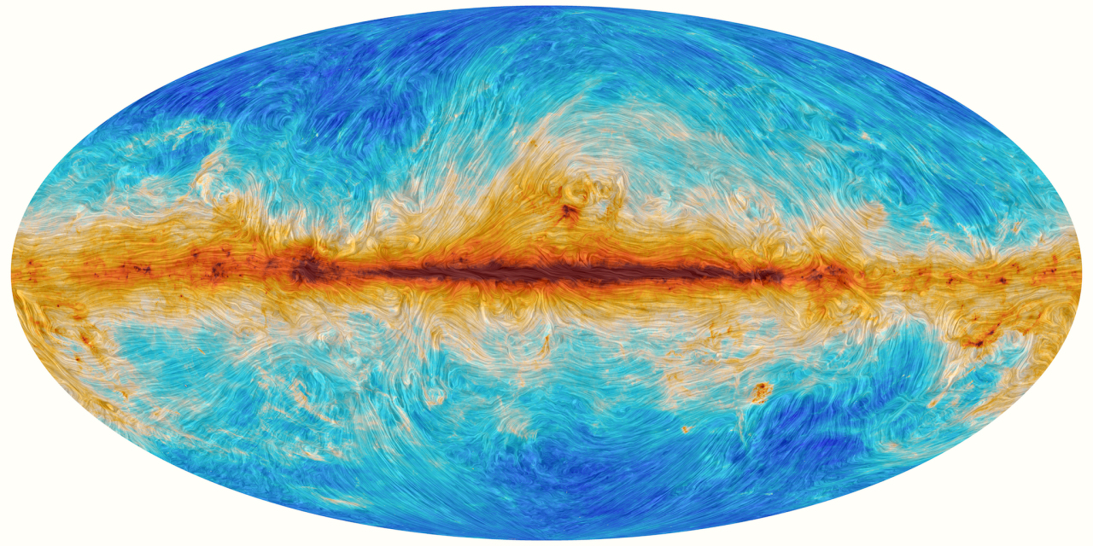
A New Turbulence Measure from Multi-frequency Synchrotron Polarization
Recover the turbulence spectrum and anisotropy from polarization maps without RM synthesis.
We introduce a directional-spectrum measure computed directly from Q and U.
Aliaksandr Melnichenka
Berea College
American Astronomical Society (AAS 248)
January 7, 2026
Phoenix, AZ.
Alex Lazarian (UW Madison)
Dmitry Pogosyan (University of Alberta)
Notes:
Names, conference name
“Imagine recovering the spectrum of interstellar magnetic turbulence from just one polarization map at one radio frequency. No RM synthesis. No wide bandwidth. That’s the core result of our work.”

Slide 2
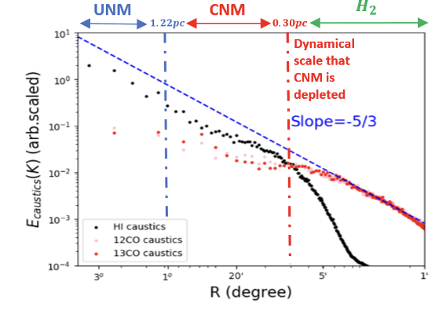
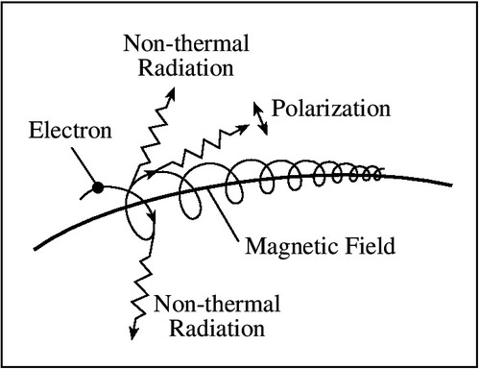
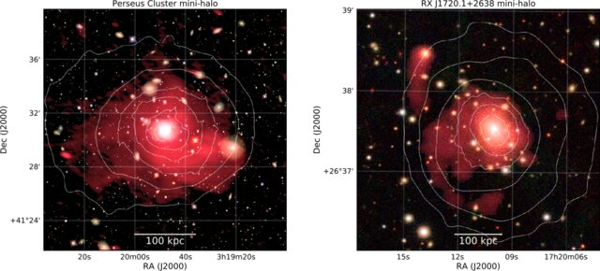
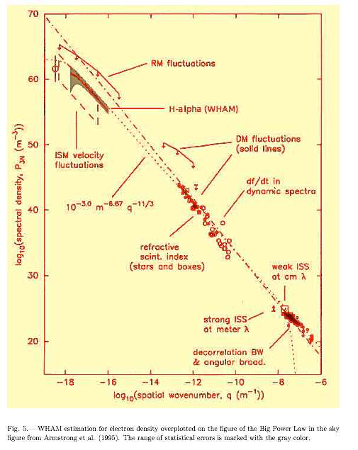
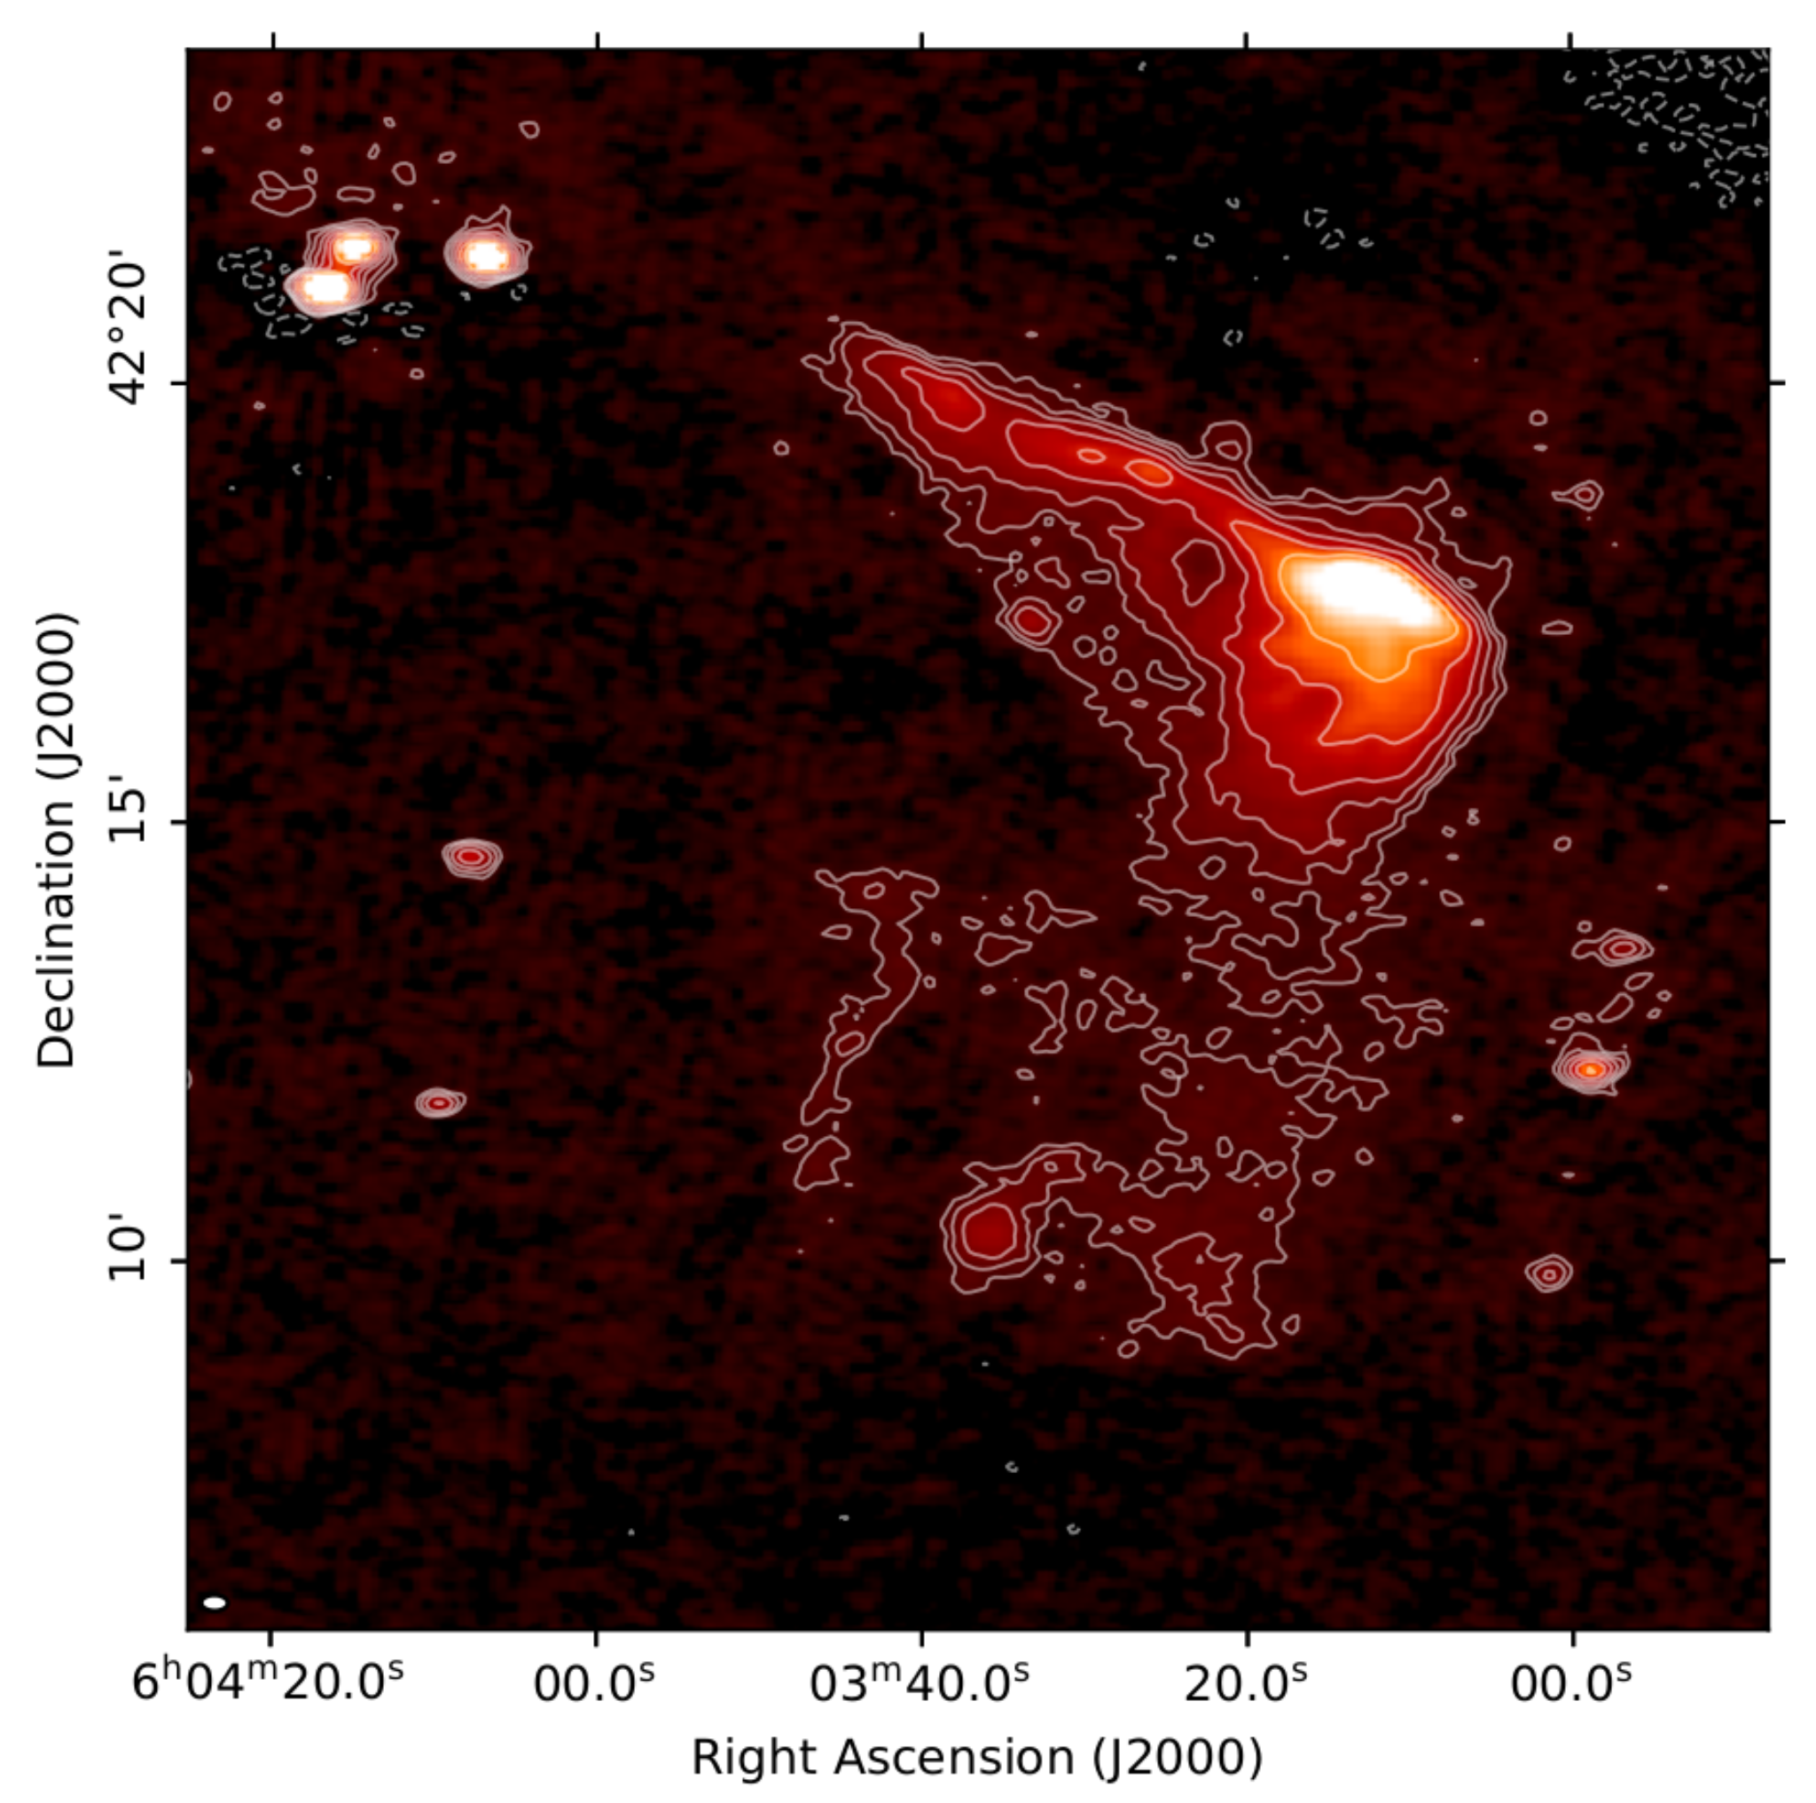
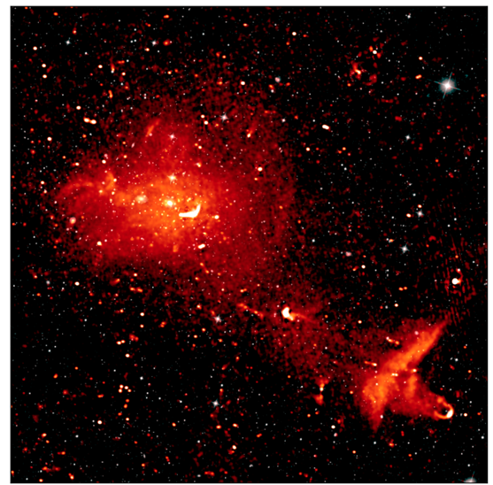
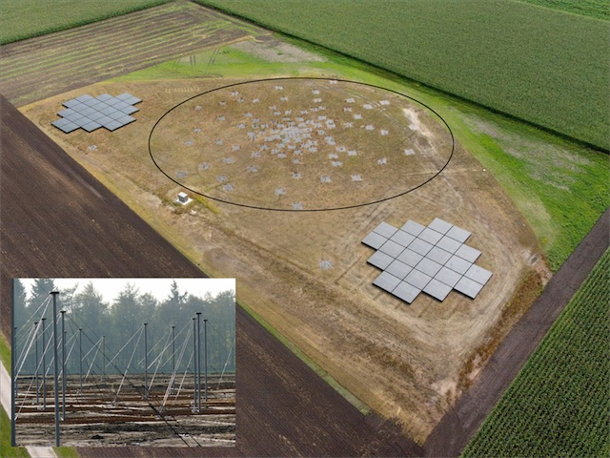
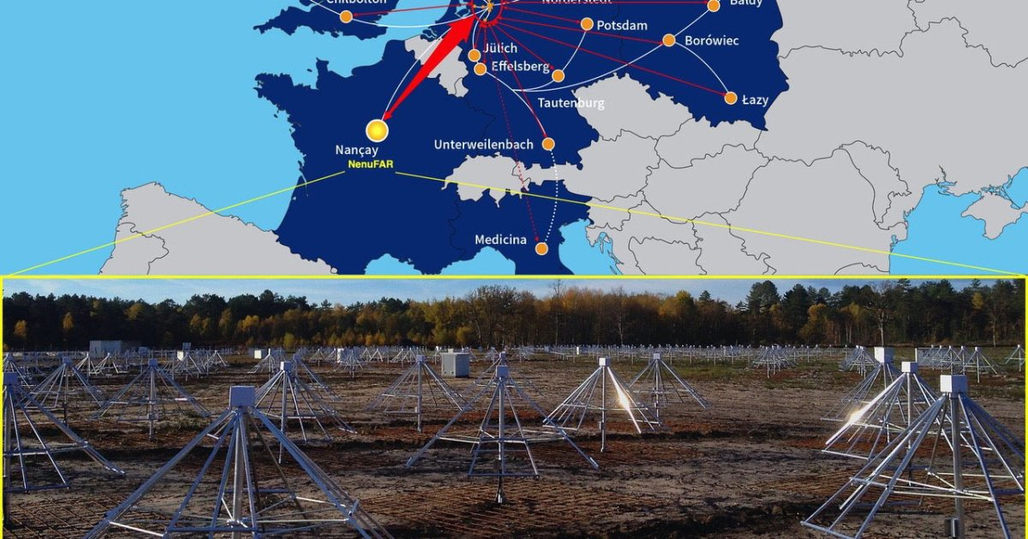
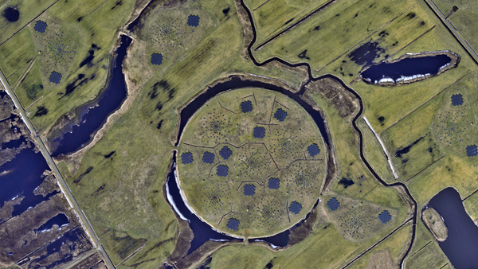
Why turbulence? Why polarization maps?
Interstellar Medium
Typical magnetic field tracing method: synchrotron polarization
Velocity fluctuations
Interstellar Medium
van Weeren et al. (2019)
Density fluctuations
Taurus region
Synchrotron emission
420 pc
140pc
46.7pc
11.7pc
Bonafede et al. (2022)
2.3pc
Kolmogorov spectrum
Wittor Denis (2023)
Distance (degrees,pc)
LOFAR
Yuen, Ho & AL 2021
New radio surveys
large sky coverage, many wavelengths
Armstrong+ 95;
Chepurnov & AL 09
Kolmogorov spectrum is common in Astrophysics
(star formation, transport, cosmic rays, heating)
Notes:
Turbulence is important in many directions.
It’s important to study the cosmic rays, the accelerations, for star formation.
For all of this is important, because all liquids in astrophysics are turbulent. And turbulence changes all of their properties.
Synchrotron polarization traces magnetic turbulence across scales

Slide 3
People already studing the following
There are already experts who build their carrier based on the analysis of turbulence.
For example, Marijke Haverkorn argued … In faraday screen, the injection range of turbulence is 10pc; but this is not so, since she misidentified what affects the faraday rotation. On faraday rotation is affected not by the magnetic field, but density affects.
So, if density are clumps associated with H1 regions and others, and they are not going over 10pc, the faraday spectr will also have the spectral break at 10pc.
And they introduced the following measures.
But advantage of measure I introduce, it shows advantages compared to previous measures.

Slide 4
People already studing the following
It is important to distinguish: there is one spectr, and there is another. And studying them separately is important. But when we start to measure, some measures are mixed. Because, of this it is important to emphasize them and separate.
So we suggest a new method of separation. So observers could distinguish what is faraday and what is intristic. And we could estimate the transitional range, and regime, when two effects are mixed.
And the presence of more than one measure allows to more accurately study the separation, and determine what is what.

Slide 5
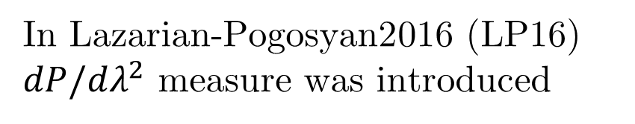
Studying turbulence, there are different
Scattering
Something else
But what are the other ways to study?
In Lazarian-Pogosyan2016 (LP16)
$dP/dλ^{2}$ measure was introduced
It is disadvantage is that we have to take the derivative
Notes:
title
Planck, sections
Next slide: Faraday, path alternatives
Synchrton as good measure of magnetic field
informant
Magnetic turbulence is ubiquitous in astrophysics
(Armstrong et al. 1995). It shapes star formation (Fed-
errath 2016), angular momentum transport (Balbus &
Hawley 1991), and mediates conductivity and cosmic-
ray propagation (Brandenburg & Lazarian 2013), yet
most observational diagnostics are limited to 2D pro-
jections along the line of sight (LOS) (Elmegreen &
Scalo 2004). Faraday rotation is one of the most widely
used probes of these magnetized plasmas: from Galac-
tic RM grids and pulsars to cluster radio halos and FRBs, it reveals the LOS magnetic field weighted by
the thermal-electron density, and—through its spatial
statistics—encodes the underlying turbulence (e.g., see
the review by Akahori et al. 2018).

Slide 6
Directional Spectrum Measure
On the other hand, we propose a measure, that doesn’t require the derivative.
It could be occurred directly from Q and U stokes parameters, that are available directly from the observations.
Notes:
title
Planck, sections
Next slide: Faraday, path alternatives
Synchrton as good measure of magnetic field
informant
Magnetic turbulence is ubiquitous in astrophysics
(Armstrong et al. 1995). It shapes star formation (Fed-
errath 2016), angular momentum transport (Balbus &
Hawley 1991), and mediates conductivity and cosmic-
ray propagation (Brandenburg & Lazarian 2013), yet
most observational diagnostics are limited to 2D pro-
jections along the line of sight (LOS) (Elmegreen &
Scalo 2004). Faraday rotation is one of the most widely
used probes of these magnetized plasmas: from Galac-
tic RM grids and pulsars to cluster radio halos and FRBs, it reveals the LOS magnetic field weighted by
the thermal-electron density, and—through its spatial
statistics—encodes the underlying turbulence (e.g., see
the review by Akahori et al. 2018).

Slide 7
How this complementary measures are working?
First of all, we consider the polarization angle fluctuations.
If just the fluctions of angle colmogorov spectrum, the angle fluctuations are given a good Kolmogorov spectrum as well.
BUT. Consider the fluctuations in intristic are Kolmogorov (we are expecting this), but the Faraday screen fluctuations not Kolmogorov.
why? Because the faraday screen fluctuations have two components: magnetic field (mostly kolmogorov) and density (it could be any; in particular, shallow).
Notes:
title
Planck, sections
Next slide: Faraday, path alternatives
Synchrton as good measure of magnetic field
informant
Magnetic turbulence is ubiquitous in astrophysics
(Armstrong et al. 1995). It shapes star formation (Fed-
errath 2016), angular momentum transport (Balbus &
Hawley 1991), and mediates conductivity and cosmic-
ray propagation (Brandenburg & Lazarian 2013), yet
most observational diagnostics are limited to 2D pro-
jections along the line of sight (LOS) (Elmegreen &
Scalo 2004). Faraday rotation is one of the most widely
used probes of these magnetized plasmas: from Galac-
tic RM grids and pulsars to cluster radio halos and FRBs, it reveals the LOS magnetic field weighted by
the thermal-electron density, and—through its spatial
statistics—encodes the underlying turbulence (e.g., see
the review by Akahori et al. 2018).

Slide 8
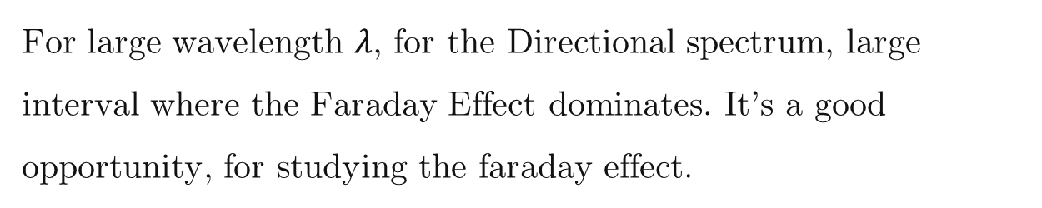
Let’s analyze how those two measure works
For large wavelength $λ$, for the Directional spectrum, large interval where the Faraday Effect dominates. It’s a good opportunity, for studying the faraday effect.
Marijke Haverkorn changed the wavelength – this is a more traditional method.
But we don’t change the wavelength, because of the studying the spectrum.
Thus two measures are complementary. Intristic fluctuations could be measures by styding the non-polarized synchroted – spatial fluctuations give the information about synchrotron screen.
Notes:
title
Planck, sections
Next slide: Faraday, path alternatives
Synchrton as good measure of magnetic field
informant
Magnetic turbulence is ubiquitous in astrophysics
(Armstrong et al. 1995). It shapes star formation (Fed-
errath 2016), angular momentum transport (Balbus &
Hawley 1991), and mediates conductivity and cosmic-
ray propagation (Brandenburg & Lazarian 2013), yet
most observational diagnostics are limited to 2D pro-
jections along the line of sight (LOS) (Elmegreen &
Scalo 2004). Faraday rotation is one of the most widely
used probes of these magnetized plasmas: from Galac-
tic RM grids and pulsars to cluster radio halos and FRBs, it reveals the LOS magnetic field weighted by
the thermal-electron density, and—through its spatial
statistics—encodes the underlying turbulence (e.g., see
the review by Akahori et al. 2018).

Slide 9
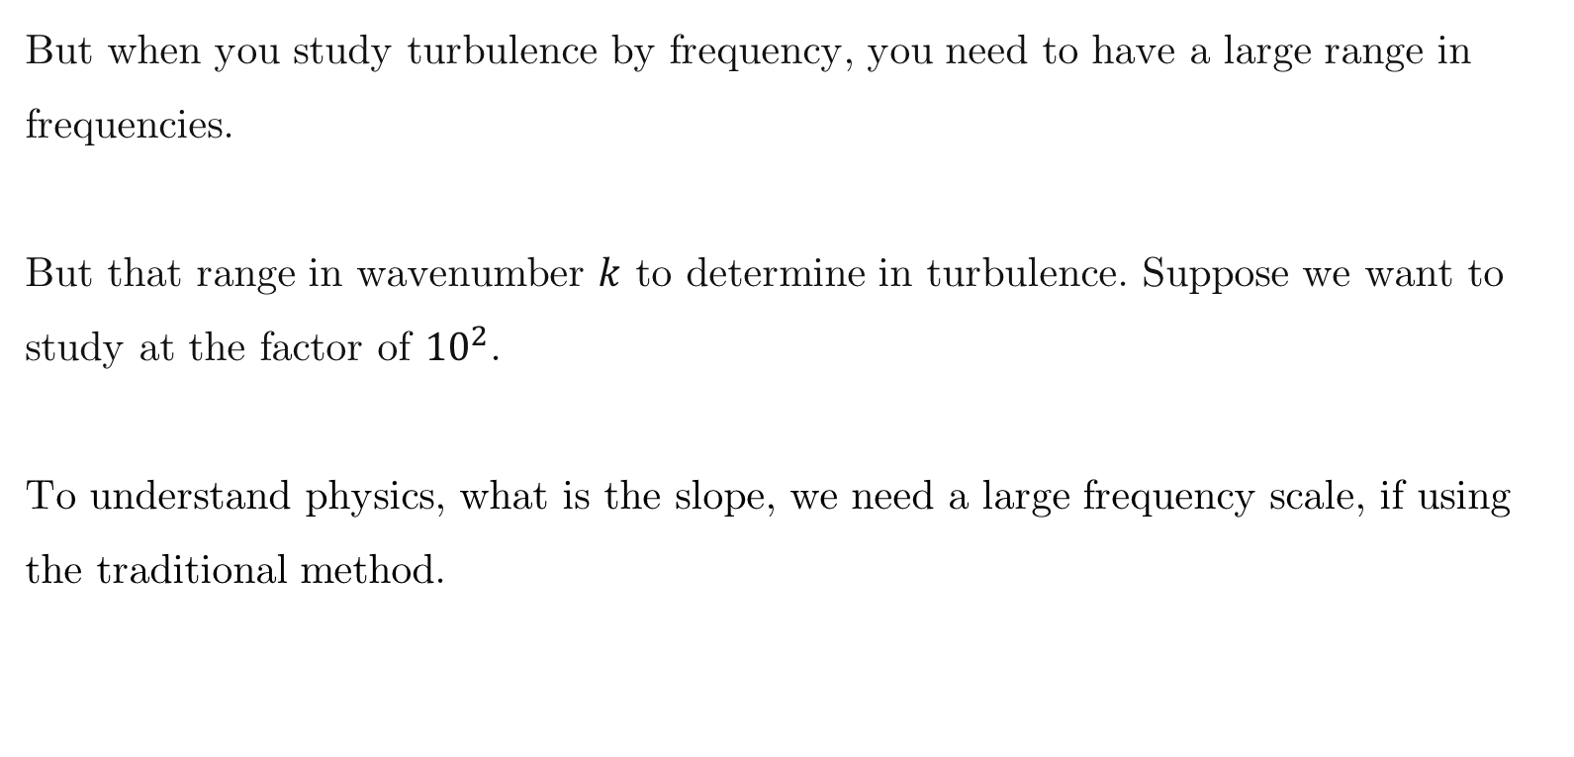
History
This question is huge, and people had studied this for a long period of time [TODO: check literature].
But when you study turbulence by frequency, you need to have a large range in frequencies.
But that range in wavenumber $k$ to determine in turbulence. Suppose we want to study at the factor of ${10}^{2}$.
To understand physics, what is the slope, we need a large frequency scale, if using the traditional method.
Notes:
title
Planck, sections
Next slide: Faraday, path alternatives
Synchrton as good measure of magnetic field
informant
Magnetic turbulence is ubiquitous in astrophysics
(Armstrong et al. 1995). It shapes star formation (Fed-
errath 2016), angular momentum transport (Balbus &
Hawley 1991), and mediates conductivity and cosmic-
ray propagation (Brandenburg & Lazarian 2013), yet
most observational diagnostics are limited to 2D pro-
jections along the line of sight (LOS) (Elmegreen &
Scalo 2004). Faraday rotation is one of the most widely
used probes of these magnetized plasmas: from Galac-
tic RM grids and pulsars to cluster radio halos and FRBs, it reveals the LOS magnetic field weighted by
the thermal-electron density, and—through its spatial
statistics—encodes the underlying turbulence (e.g., see
the review by Akahori et al. 2018).

Slide 10
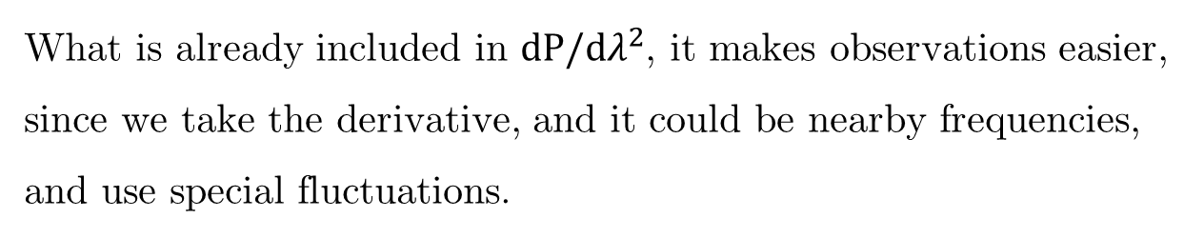
History
What is already included in $dP/dλ^{2}$, it makes observations easier, since we take the derivative, and it could be nearby frequencies, and use special fluctuations.
The using of a new measure, makes the observations easier, and most importantly give a new information.
Notes:
title
Planck, sections
Next slide: Faraday, path alternatives
Synchrton as good measure of magnetic field
informant
Magnetic turbulence is ubiquitous in astrophysics
(Armstrong et al. 1995). It shapes star formation (Fed-
errath 2016), angular momentum transport (Balbus &
Hawley 1991), and mediates conductivity and cosmic-
ray propagation (Brandenburg & Lazarian 2013), yet
most observational diagnostics are limited to 2D pro-
jections along the line of sight (LOS) (Elmegreen &
Scalo 2004). Faraday rotation is one of the most widely
used probes of these magnetized plasmas: from Galac-
tic RM grids and pulsars to cluster radio halos and FRBs, it reveals the LOS magnetic field weighted by
the thermal-electron density, and—through its spatial
statistics—encodes the underlying turbulence (e.g., see
the review by Akahori et al. 2018).

Slide 11
Directional spectrum analysis
We have the asymptotics and we change the parameters
TODO: use not chi but lambda.
Show two three values for lambda.
Notes:
title
Planck, sections
Next slide: Faraday, path alternatives
Synchrton as good measure of magnetic field
informant
Magnetic turbulence is ubiquitous in astrophysics
(Armstrong et al. 1995). It shapes star formation (Fed-
errath 2016), angular momentum transport (Balbus &
Hawley 1991), and mediates conductivity and cosmic-
ray propagation (Brandenburg & Lazarian 2013), yet
most observational diagnostics are limited to 2D pro-
jections along the line of sight (LOS) (Elmegreen &
Scalo 2004). Faraday rotation is one of the most widely
used probes of these magnetized plasmas: from Galac-
tic RM grids and pulsars to cluster radio halos and FRBs, it reveals the LOS magnetic field weighted by
the thermal-electron density, and—through its spatial
statistics—encodes the underlying turbulence (e.g., see
the review by Akahori et al. 2018).

Slide 12

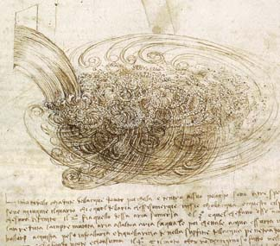
Turbulence is a chaotic order
c.1500
L. Da Vinci
It is important to know the laws of this order and use them
Notes:
Long before modern fluid dynamics, Leonardo da Vinci recognized that turbulence is not pure randomness — it’s an organized chaos. He saw repeating patterns in water eddies, a hierarchy of motion that hinted at an underlying order. This idea — order within chaos — became the foundation of modern turbulence theory, from Kolmogorov to MHD turbulence.

Slide 13

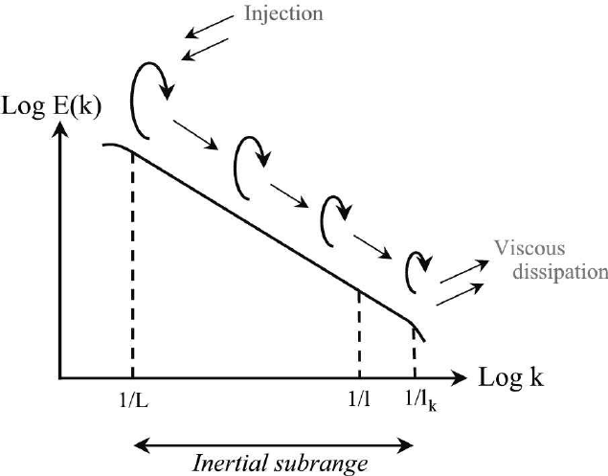
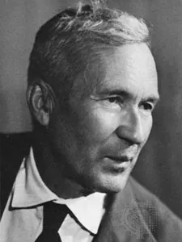
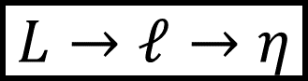
Turbulent energy cascade
$$L→ℓ→η$$
Constant turbulent energy transfer rate
https://commons.wikimedia.org/w/index.php?curid=64829708
Notes:
This process transfers kinetic energy from large scales (where it’s injected) to small scales (where it dissipates as heat).

Slide 14
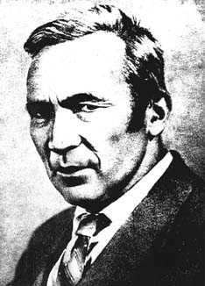
Kolmogorov theory reveals order in chaos for incompressible hydro turbulence
V²_{l} ²
= const
t _{cas,l}
V_{l}³
= const, V_{l} ~ l^{1/3}
t _{cas,l} = l/V_{l}
l
Or, E(k)~k^{-5/3/3}
l
Re>>1
Re~1
Viscosity is not
important
v_{l}
Viscosity is not
important
Viscous
dissipation
Re>>1
Notes:
14

Slide 15
Typical magnetic field tracing method: synchrotron polarization
van Weeren et al. (2019)
Synchrotron emission
Wittor Denis (2023)
Bonafede et al. (2022)

Slide 16
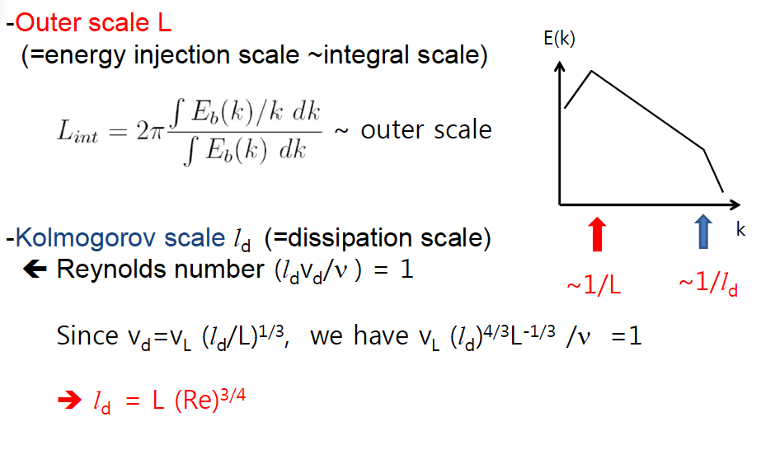
For turbulence the cascade is self-similar from the injection to the dissipation scales

Slide 17
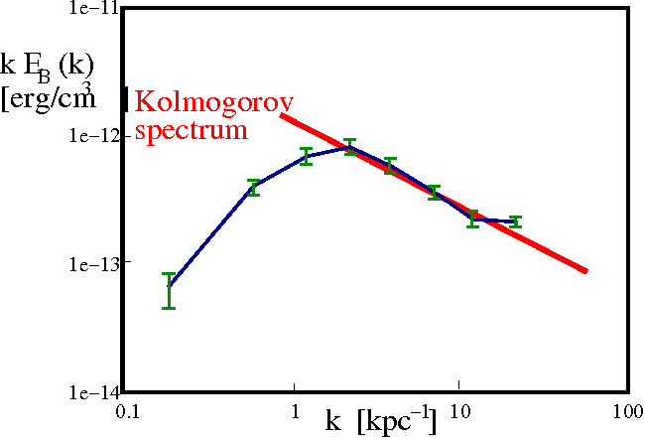
Kolmogorov spectrum is common in Astrophysics
Clusters of Galaxies
Magnetic fluctuations
Interstellar Medium
Velocity fluctuations
Interstellar Medium
Density fluctuations
Vogt & EnBlin 2005
Taurus region
420 pc
140pc
46.7pc
11.7pc
2.3pc
Distance (degrees,pc)
Kolmogorov spectrum
Yuen, Ho & AL 2021
Armstrong+ 95; Chepurnov & AL 09

Slide 18
Clusters of Galaxies
Interstellar Medium
Density fluctuations
Magnetic fluctuations
Kolmogorov spectrum
Vogt & EnBlin 2005
Armstrong+ 95; Chepurnov & AL 09

Slide 19
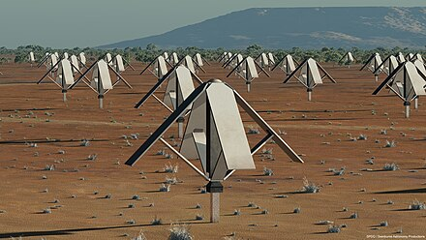
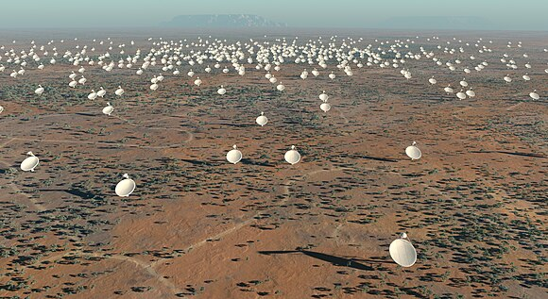
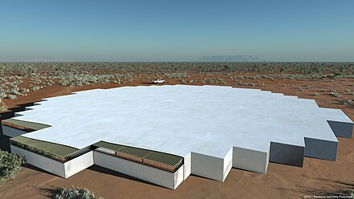
SKA to be commissioned in 2030: New data for SIGs
Notes:
For SIGs (Statistical Intensity Gradients) and turbulence diagnostics:
High dynamic range in polarization and Faraday depth;
Large survey volumes allow mapping of magnetized turbulence over many scales;

Slide 20
LOFAR is a gigantic European telescope measuring at 2 to 15 m radio wavelength

Slide 21
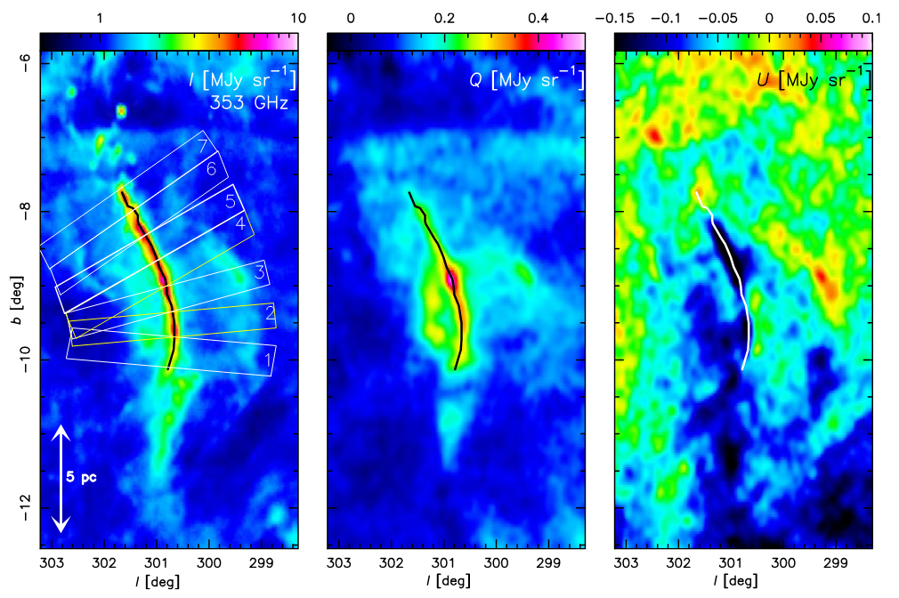
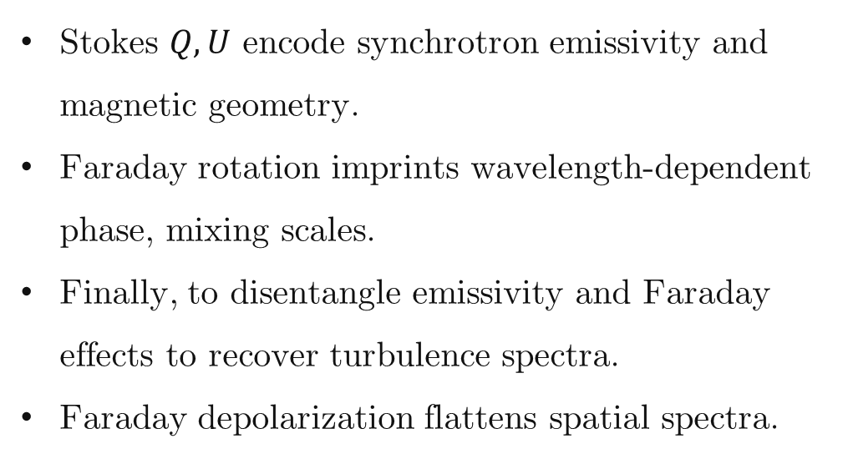
Why polarization maps? What current surveys give us
Stokes $Q, U$ encode synchrotron emissivity and magnetic geometry.
Faraday rotation imprints wavelength-dependent phase, mixing scales.
Finally, to disentangle emissivity and Faraday effects to recover turbulence spectra.
Faraday depolarization flattens spatial spectra.
Planck PR3 (2018) $353−GHz, I, Q, U$ full-sky maps (HEALPix)
We analyze spatial structure from wavelength to separate physical effects
Notes:
title
Planck, sections
Next slide: Faraday, path alternatives
Synchrton as good measure of magnetic field
informant
Magnetic turbulence is ubiquitous in astrophysics
(Armstrong et al. 1995). It shapes star formation (Fed-
errath 2016), angular momentum transport (Balbus &
Hawley 1991), and mediates conductivity and cosmic-
ray propagation (Brandenburg & Lazarian 2013), yet
most observational diagnostics are limited to 2D pro-
jections along the line of sight (LOS) (Elmegreen &
Scalo 2004). Faraday rotation is one of the most widely
used probes of these magnetized plasmas: from Galac-
tic RM grids and pulsars to cluster radio halos and FRBs, it reveals the LOS magnetic field weighted by
the thermal-electron density, and—through its spatial
statistics—encodes the underlying turbulence (e.g., see
the review by Akahori et al. 2018).

Slide 22
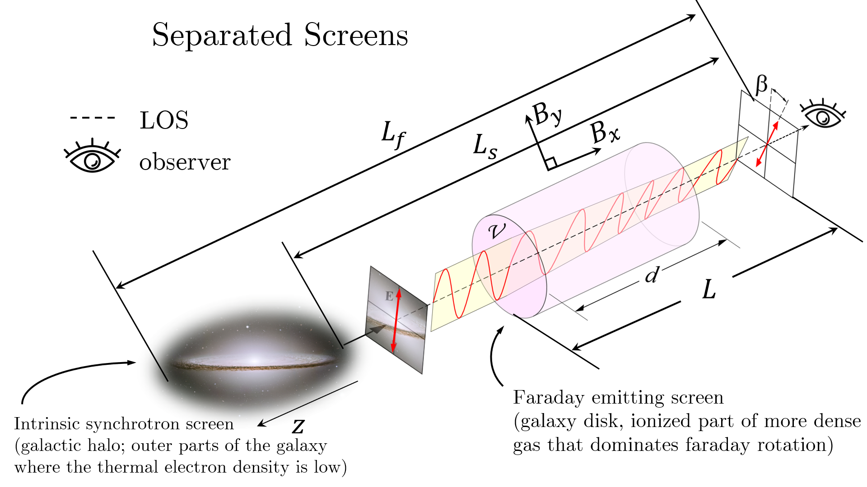
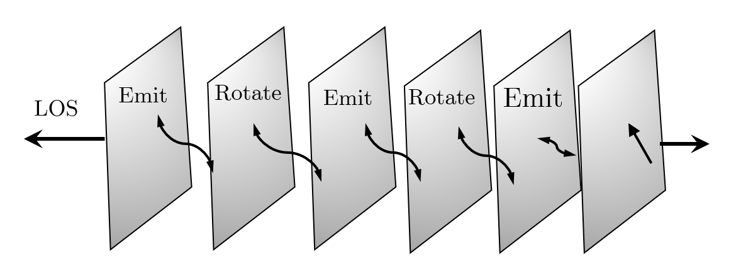
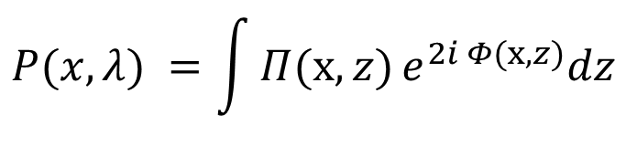
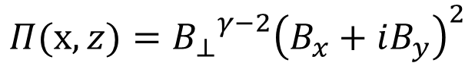

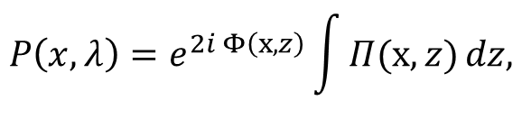
Propagation geometries: separated screen and mixed volume
With emissivity ($γ=2$):
$$Π(x,z)={{B_{⊥}}^{γ−2}\left(B_{x}+iB_{y}\right)}^{2}$$
Separated screen
(external RM screen in front of emitter)
Mixed volume
(emission and rotation in the same region)
$$P\left(x, λ\right)=e^{2i Φ\left(x,z\right)}\int{Π(x,z)}dz,$$
$$P(x, λ) =\int{Π(x,z)}e^{2i Φ(x,z)}dz$$
Notes:
Lazarian_Pogosyan_2022 “At wavenumber k, the winner is set by a simple rule: when λ² times the RM dispersion at k is about one, the dominance flips. We call the corresponding wavenumber k-cross, and we can measure it from a single map. As λ increases, k-cross slides to smaller k, revealing a clean, predictable transition from synchrotron-dominated to Faraday-dominated structure.”

Slide 23
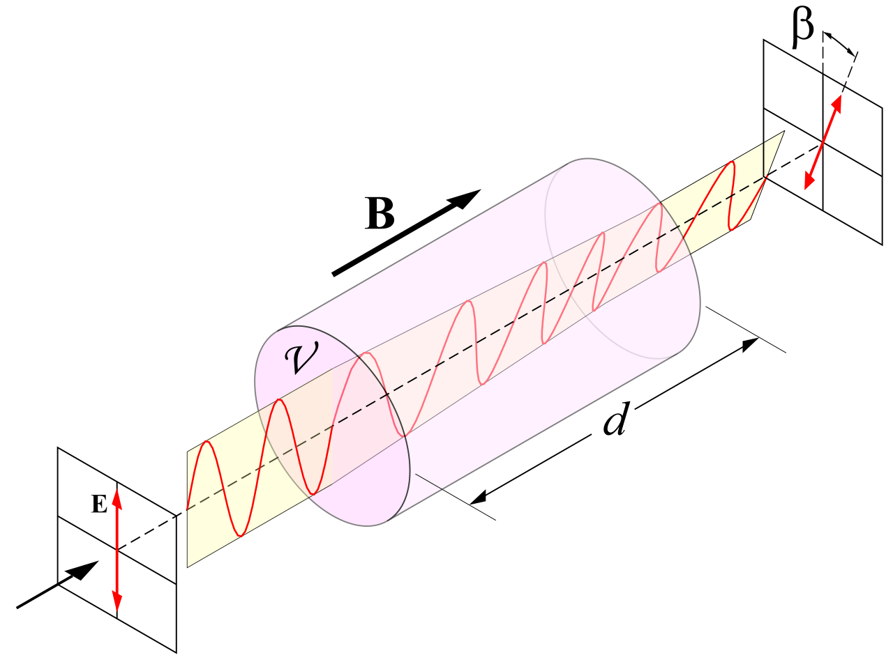

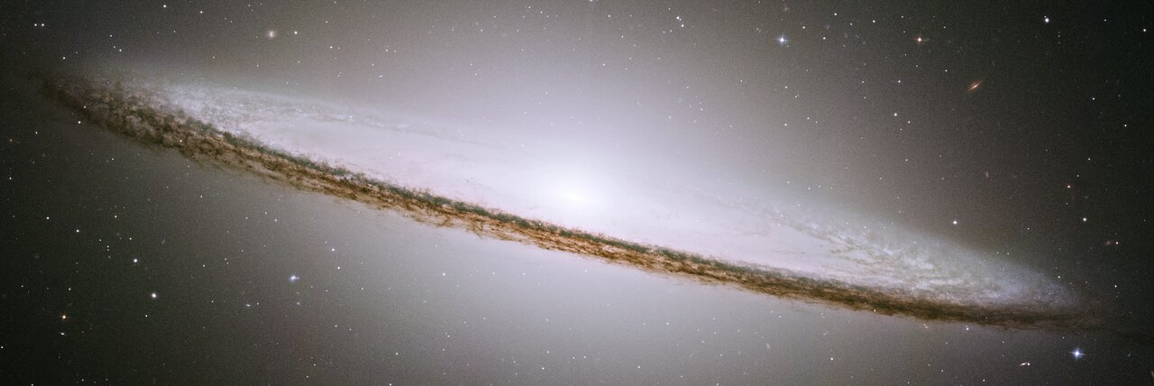
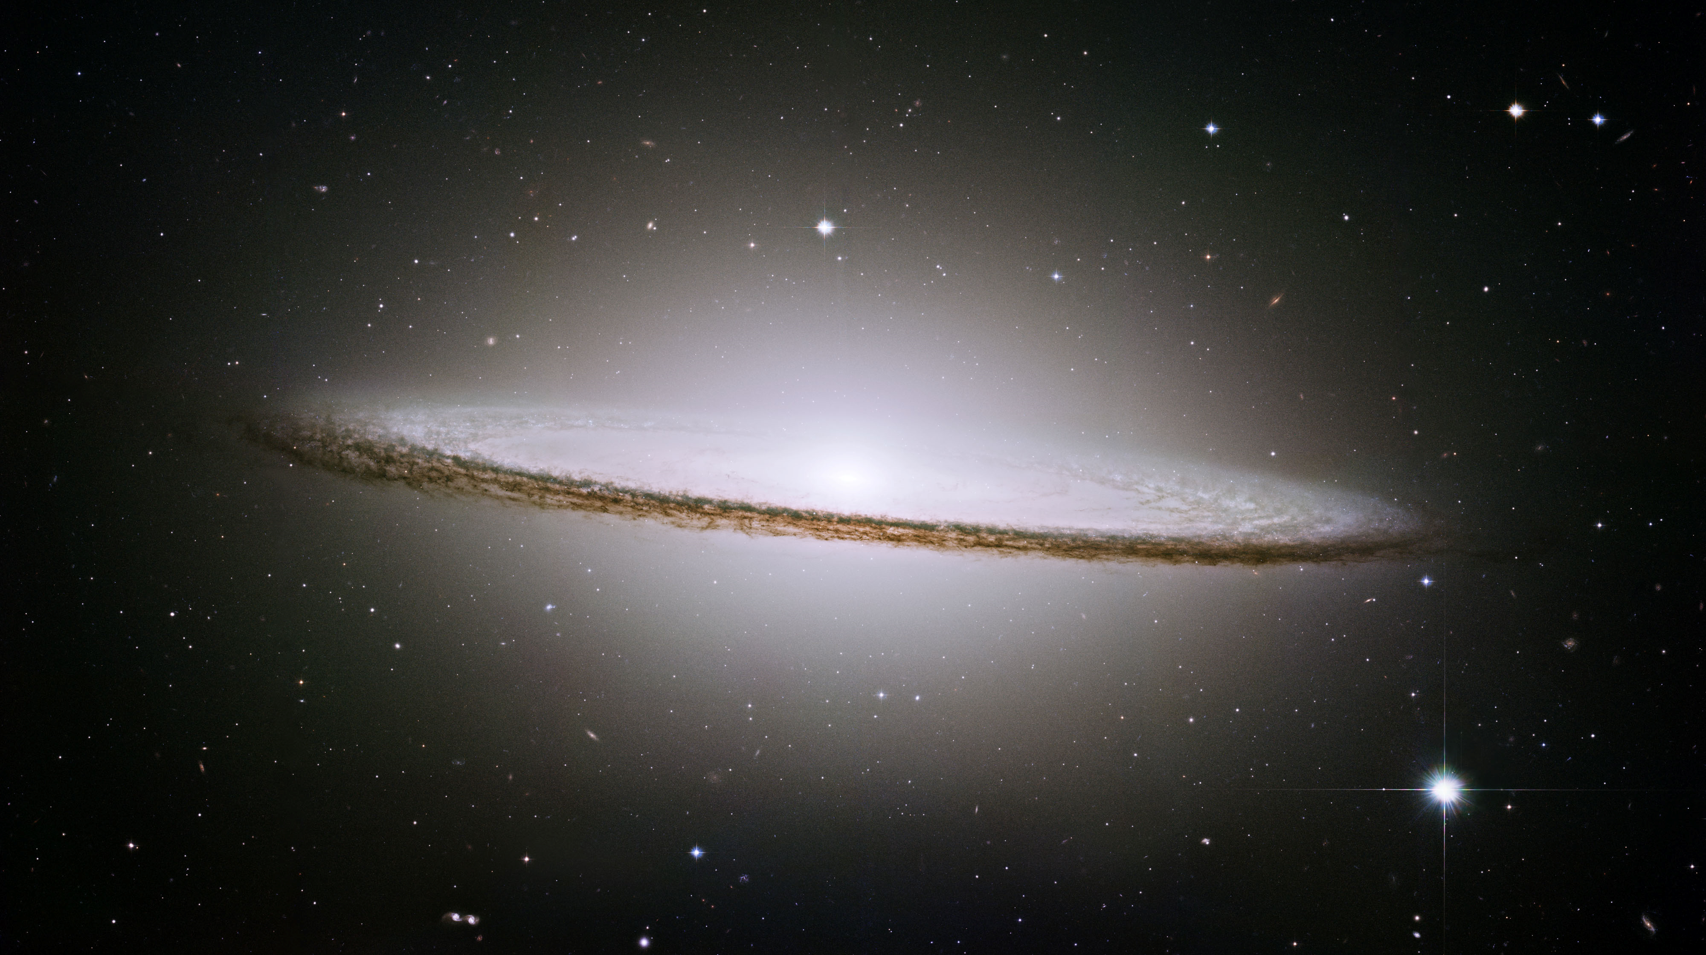
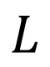
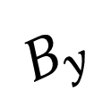
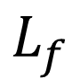
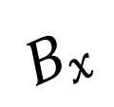
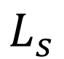
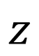
Separated Screens
LOS
$$B_{y}$$
$$L_{f}$$
$$B_{x}$$
$$L_{s}$$
observer
$$L$$
Faraday emitting screen
(galaxy disk, ionized part of more dense gas that dominates faraday rotation)
$$z$$
Intrinsic synchrotron screen
(galactic halo; outer parts of the galaxy
where the thermal electron density is low)
Notes:
The focus on this paper was on the most complex situation when the sources of the synchrotron radiation and thermal electrons
causing Faraday rotation occupy the same volume. Much simpler, but also astrophysically important, is the situation when
synchrotron originates in one distinct region while Faraday rotation acts on synchrotron radiation in another region. For instance, in
the studies of synchrotron emission from high galactic latitudes, one may consider that the synchrotron emission is generated in the
galactic halo, while the regions of the galactic disk close to the observer are responsible for the Faraday rotation. Below we cover this
special case of synchrotron turbulence study

Slide 24
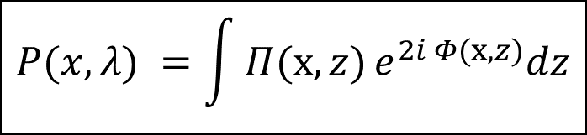
Mixed Volume
$$P(x, λ) =\int{Π(x,z)}e^{2i Φ(x,z)}dz$$
Rotate
Emit
Emit
Rotate
LOS
Emit

Slide 25
Polarization Angle Directional Correlation (PADC)
Compute from one map :
$$S(R) = ⟨\sin^{2}{[2(χ(x) − χ(x+R))]}⟩$$
New measure: directional spectrum (2-D Fourier power)
$$P_{dir}\left(k\right)={|FFT(cos(2χ)|}^{2}+{|FFT(sin(2χ)|}^{2}$$
Why it works:
no angle unwrapping
robust to filtering
directly maps to power spectrum
Notes:
NIO:: sin^2; constn!!“

Slide 26
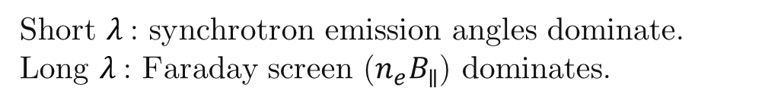
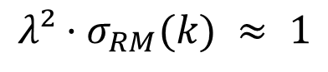
Emission vs. Faraday Screen: who dominates?
Polarization model (external screen):
$$P(x, λ) =e^{2i [ ψ_{emit}\left(x\right)+ λ^{2}RM\left(x\right)]}$$
Transition criterion (at scale k):
$$λ²·σ_{RM}(k) ≈ 1$$
defines crossover $k_{×} (λ)$
Short $λ$: synchrotron emission angles dominate.
Long $λ$: Faraday screen ($n_{e}B_{∥}$) dominates.
Standard Deviation of Rotation Measure
Notes:
1. Initiallly Draw the picture halo, thickness, and so on on the front title 2. here, plot when the dispertion increases (plot the layer, and some вихри) 3. more transition to simulations addres.
“At wavenumber k, the winner is set by a simple rule: when λ² times the RM dispersion at k is about one, the dominance flips. We call the corresponding wavenumber k-cross, and we can measure it from a single map. As λ increases, k-cross slides to smaller k, revealing a clean, predictable transition from synchrotron-dominated to Faraday-dominated structure.”

Slide 27
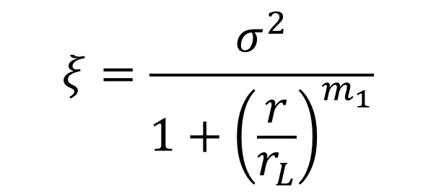
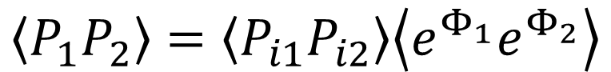

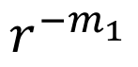
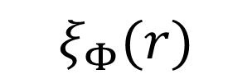
$$\left\langle P_{1}P_{2}\right\rangle =\left\langle P_{i1}P_{i2}\right\rangle \left\langle e^{Φ_{1}}e^{Φ_{2}}\right\rangle$$
$$ξ_{1}(r)$$
$$ξ_{Φ}(r)$$
$$ξ$$
$$r_{1}$$
$$r^{−m_{1}}$$
$$r_{φ}$$
$$ξ=\frac{σ^{2}}{1+{\left(\frac{r}{r_{L}}\right)}^{m_{1}}}$$
$$r_{1}$$

Slide 28
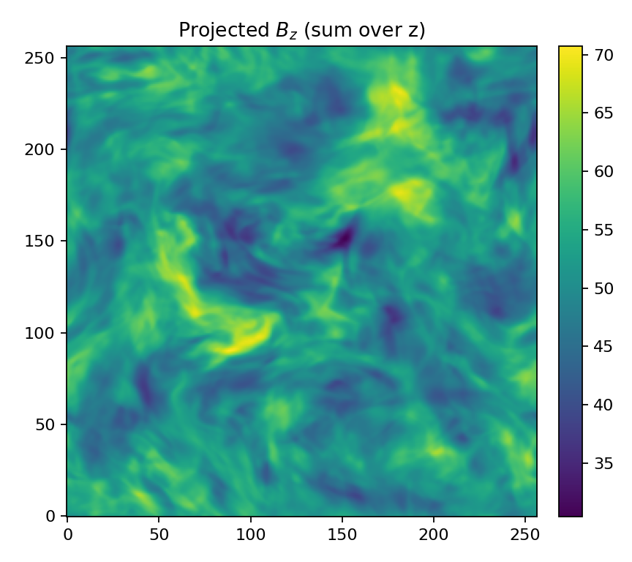
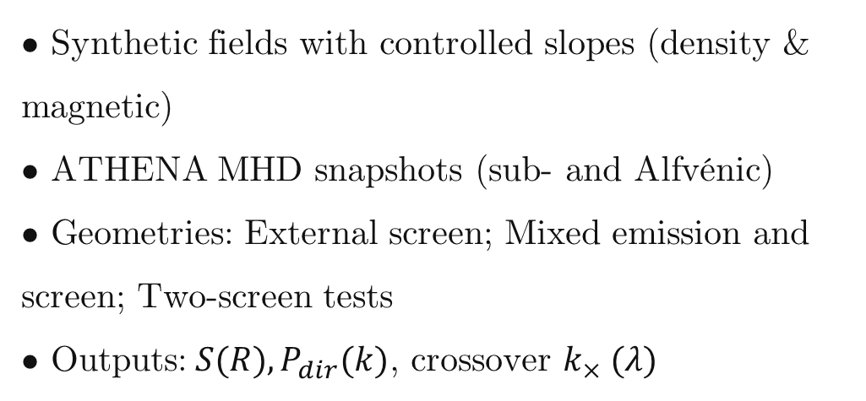
Simulation design
• Synthetic fields with controlled slopes (density & magnetic)
• ATHENA MHD snapshots (sub‑ and Alfvénic)
• Geometries: External screen; Mixed emission and screen; Two‑screen tests
• Outputs:$S(R), P_{dir}(k)$, crossover $k_{×} (λ)$
$$M_{A}=0.8,M_{S}=1.0$$
Notes:
“We validated this in two ways. First, on synthetic fields with controlled power laws, where we know the answer. Across wavelengths, the directional spectrum follows the synchrotron slope at short λ and the RM slope at long λ, with the predicted cross-over behavior. In a density-slope test, once Faraday dominates, the spectrum locks onto n-e times B-parallel, exactly as expected.

Slide 29
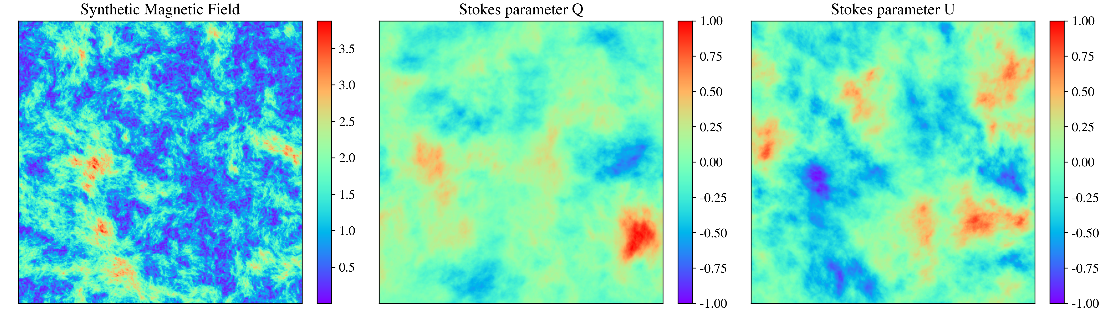
Stokes Parameters of the Synthetic Magnetic Field
Notes:
Larger titles;
TITLES- - what is written

Slide 30

Notes:
Put what regime we are right now? Synchrotron-dominated? Transitional? Faraday-dominated?

Slide 31

Notes:
Second, on 3-D Athena MHD cubes spanning sub- and super-Alfvénic regimes. Projected maps recover the anticipated inertial-range scaling; the measured two-dimensional slopes match the three-to-two-D mapping.

Slide 32

Four complementary measures
Polarization Frequency Analysis (PFA): $\left\langle {|P\left(λ\right)|}^{2}\right\rangle$
Polarization Spatial Analysis (PSA): $P_{2D}(k;λ)$
Derivative: PSA of $\frac{dP}{dλ^{2}}$
Directional spectrum:
LP16
$$P_{dir}\left(k\right)={|FFT(cos(2χ)|}^{2}+{|FFT(sin(2χ)|}^{2}$$

Slide 33


Slide 34


Slide 35


Slide 36


Slide 37




$$m_{φ}=−2/3$$
$$−2/L$$
$$−2/L$$

Slide 38






$$λ=0, χ=0$$
$$−3−m_{φ}=−11/3$$
$$−2/L$$
$$−2/L$$

Slide 39



$$−3+m_{φ}=−7/3$$
$$−2/L$$
$$−2/L$$

Slide 40


Slide 41


Slide 42


Slide 43








Slide 44
Results
We can extract the polarization data
The new measure is new and progressive
Directional measure better previous measures

Slide 45
The Polarization Directional Spectrum - A New Turbulence Measure from Multi-frequency Synchrotron Polarization
Aliaksandr Melnichenka
Berea College
American Astronomical Society (AAS 248)
January 7, 2026
Phoenix, AZ.
Alex Lazarian (UW Madison)
Dmitry Pogosyan (University of Alberta)
Notes:
Names, conference name
“Imagine recovering the spectrum of interstellar magnetic turbulence from just one polarization map at one radio frequency. No RM synthesis. No wide bandwidth. That’s the core result of our work.”

